Slide 1
Frequency Domain Representation

Slide 2
Eigen-functions
An eigenvector of a matrix H is any vector x that satisfies Hx = λx.
The matrix leaves its eigenvectors unchanged except for a scale factor λ, which is the eigenvalue associated with that eigenvector.
The complex exponential signal e^{j2πf0t} is an eigen-function of the LTI system with impulse response h, with eigenvalue H(f₀).
Complex exponentials are eigen-functions of any LTI system. : pass through unchanged, except for a scale factor. This is why we like working in the frequency domain.

Slide 3
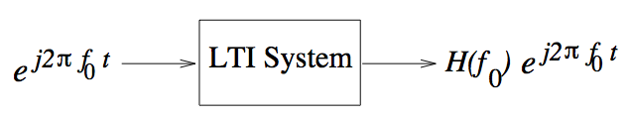
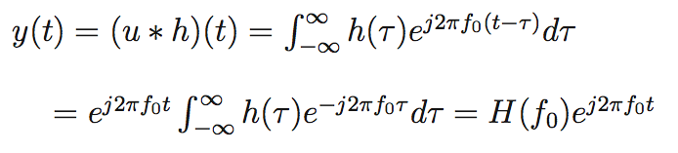
Complex exponential through LTI system
Fourier transform
of impulse response
=
System transfer function

Slide 4
Fourier Series
Fourier series represent periodic signals in terms of sinusoids or complex exponentials.
A signal u(t) is periodic with period T if u(t + T) = u(t) for all t.
If u is periodic with period T, then it is also periodic with period nT, where n is any positive integer. The smallest time interval for which u(t) is periodic is termed the fundamental period.
Let us denote this by T₀, and define the corresponding fundamental frequency f₀ = 1/T₀ (measured in Hertz if T₀ is measured in seconds).

Slide 5
Fourier Series
It can be shown that any periodic signal with period T₀ can be expressed as a linear combination of complex exponentials, whose frequencies are integer multiples of the fundamental frequency f₀.

Slide 6
Fourier Series

Slide 7
Fourier Series

Slide 8
Geometric Representation

Slide 9
Vector Expansion

Slide 10
Example
Determine the Fourier Series coefficient for a square waveform with period T₀ and amplitude varying between +1 And -1.

Slide 11
Source: Wikipedia

Slide 12
Example
Determine the Fourier Series expansion for impulse train with period T₀.

Slide 13
Fourier Series Properties

Slide 14
Properties

Slide 15
Differentiation

Slide 16
Parseval’s Identity

Slide 17
Problem

Slide 18
Questions
1. What are the conditions for Fourier Series to exist for a periodic signal?
2. Does the differentiation rule give correct Fourier Transform of the square waveform?

Slide 19



Fourier Transform
Fourier Transform
Inverse Fourier Transform
Notation for Fourier Transform Pair

Slide 20




Fourier Transform Properties
LINEARITY
TRANSLATION
Time delay corresponds to linear phase in frequency domain
Frequency shift corresponds to modulation by complex exponential in time domain
TIME/FREQ SCALING
Time compression leads
to freq expansion, and
vice versa

Slide 21
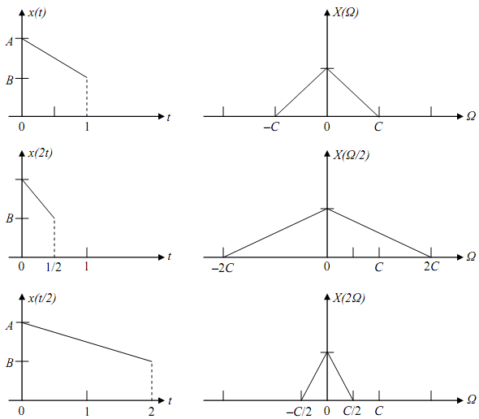
Time Frequency Scaling

Slide 22





Fourier Transform Properties
COMPLEX CONJUGATION
Complex conjugation in one domain corresponds to
flip and conjugation in the other
Important implication: the spectrum of real-valued signals is conjugate symmetric
Conjugate symmetry in rectangular coordinates:
Real part of spectrum is symmetric
Imaginary part of spectrum anti-symmetric
Conjugate symmetry in polar coordinates:
Magnitude of spectrum is symmetric
Phase of spectrum is anti-symmetric

Slide 23


Parseval’s Identity
Inner product can be computed in either time or frequency domain
Important implication: energy can be computed in time or frequency domain

Slide 24

Fourier Transform Properties
Convolution Multiplication

Slide 25

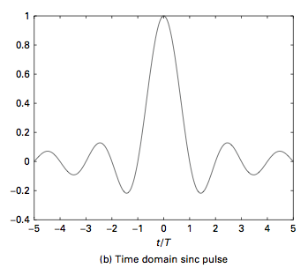
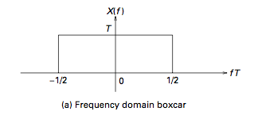
Boxcar and Sinc
Timelimited signals with sharp edges decay slowly with frequency: rectangular
time domain pulse has a sinc spectrum, which exhibits 1/|f| decay
By duality, ideal bandlimited signal corresponds to time domain sinc (slow decay
with time has bad implications for digital comm--intersymbol interference)

Slide 26
Fourier Transform
Determine the Fourier Transform of the boxcar function
u(t)=I_{[-T/1,T/2]}(t)

Slide 27
Fourier Transform

Slide 28
Fourier Transform

Slide 29
Exercise
Exercise: Find the Fourier transform of sinc(10t) sinc(4t)
Time t is taken to be in ms.

Slide 30
Why do we need negative frequencies?
We like working with complex exponentials because they are eigen-functions of LTI systems
Need complex exponentials at both positive and negative frequencies to span the space of square integrable signals
Real-valued sines and cosines with positive frequencies alone would also work, but these are not eigenfunctions of LTI systems, hence are less convenient.
Physical signals are real-valued (time domain)
Hence must satisfy consistency condition of conjugate symmetry (all the information resides in either positive or negative frequencies, hence only need spectrum for one of these)
Hence physical bandwidth = one-sided bandwidth

Slide 31
Bandwidth
Bandwidth of a signal quantifies its frequency occupancy
One-sided bandwidth: We only consider positive frequencies when computing bandwidth for physical signals
For example, a WiFi signal may occupy a 20 MHz bandwidth, between 2.4-2.42 GHz
Physical signals are real-valued (in the time domain)
Hence they are conjugate symmetric in the frequency domain, so we can specify them completely by their spectrum over positive frequencies
We shall also consider complex-valued (in the time domain) signals later
Complex envelope of a real-valued passband signal
It will turn out that the two-sided bandwidth of the complex envelope equals the physical (one-sided) bandwidth of the passband signal

Slide 32
Bandwidth
The bandwidth of a signal u(t) is loosely defined to be the size of the band of frequencies occupied by U(f). One option is to consider the band over which |U(f)² is within some fraction of its peak value (setting the fraction equal to 1/2 corresponds to the 3 dB bandwidth).
Other option is energy containment bandwidth, which is the size of the smallest band which contains a specified fraction of the signal energy.
Only positive frequencies count when computing bandwidth for physical (real-valued) signals. For physically realizable (i.e., real-valued) signals, bandwidth is defined as its occupancy of positive frequencies, because conjugate symmetry implies that the information at negative frequencies is redundant.

Slide 33
Energy Spectral Density and Bandwidth
Communication channels have frequency-dependent characteristics, hence it is useful to appropriately shape the frequency domain characteristics of the signals sent over them.
Spectrum is a particularly precious commodity, and it is important to quantify the frequency occupancy of communication signals.

Slide 34
Energy Spectral Density
Energy Spectral Density: The energy spectral density E_{u}(f) of a signal u(t) can be defined operationally as shown.

Slide 35


Example: bandwidth of a boxcar
s(t)
1
t
T
Energy spectral density = magnitude squared of Fourier transform
Not strictly bandlimited, but can define fractional energy containment bandwidth
One-sided fractional energy containment bandwidth B (fraction a) satisfies:
Example: a=0.99 corresponds to 99% energy containment bandwidth

Slide 36
Example
Determine the bandwidth of following signals:
u(t) = sinc(2t), where the unit of time is microseconds.
u(t) = I_{[2,4]}(t), where the unit of time is microseconds.

Slide 37
Example
The waveform is not time limited in case a. The Fourier transform would be:
u(t) = sinc(2t) ←→U(f) = 1/2I_{[−1,1]}(f)
Bandwidth is strictly limited to 1 MHz. Sampling rate would be 2 MHz.

Slide 38
Example
Timelimited waveform u(t) = I_{[2,4]}(t), is a time shifted version of
s(t) =I_{[-1,1]}(t)
S(f) = 2 sinc(2f)
U(f) = 2sinc(2f)e^{−j6πf} ,
which is not bandlimited. The 99% energy containment bandwidth W may be defined by the equation,

Slide 39
Example
The 99% energy containment bandwidth W may be defined by the equation,

Slide 40
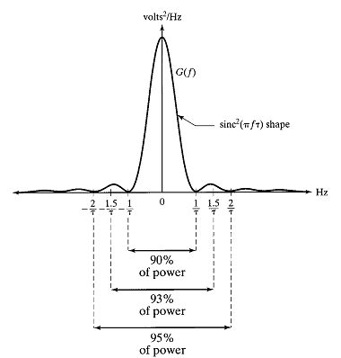
Example

Slide 41

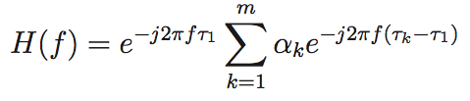
Multipath channel modeling I
Impulse response
Transfer function is a sum of sinusoids in the frequency domain
Pure delay,
can be dropped
What matters are the delay differences
Channel delay spread: determines the fastest variations in the frequency domain
Channel coherence bandwidth: Inverse of delay spread
Channel can be approximated as constant over band much smaller than coherence bw

Slide 42

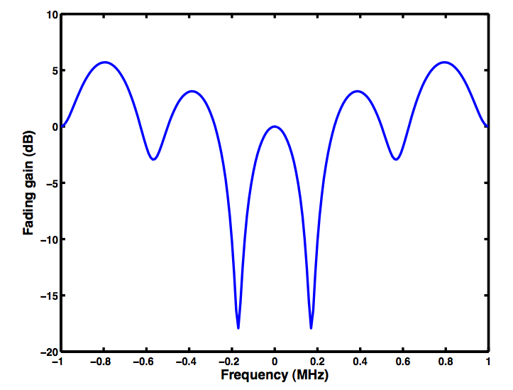
Multipath channel modeling contd, II
(ignoring pure delay term)
Time in microseconds; delay spread 2.5 microsec, coherence bandwidth 400 KHz
Frequency selective fading
can be as large as 18 dB!
Need diversity: frequency, spatial,
time (if channel varies across time)

